Slide 1
Assembly Language Programming
Addressing Modes
Department of Computer Science and Engineering
Amrita School of Engineering
Coimbatore
Data Processing Instructions

Slide 2
Objectives
Explore ARM addressing modes
- Register Addressing Mode
- Register Indirect Addressing Mode
- ARM's Autoindexing Pre-indexed Addressing Mode
- ARM's Autoindexing Post-indexing Addressing Mode
- Program Counter Relative (PC Relative) Addressing Mode
- and so on
Data Processing Instructions

Slide 3
Addressing Mode ???
There are different ways to specify the address of the operands for any given operations such as load, add or branch.
The different ways of determining the address of the operands are called addressing modes.
In this session, we are going to explore different addressing modes of ARM processor and learn how all instructions can fit into a single word (32 bits)
Data Processing Instructions

Slide 4
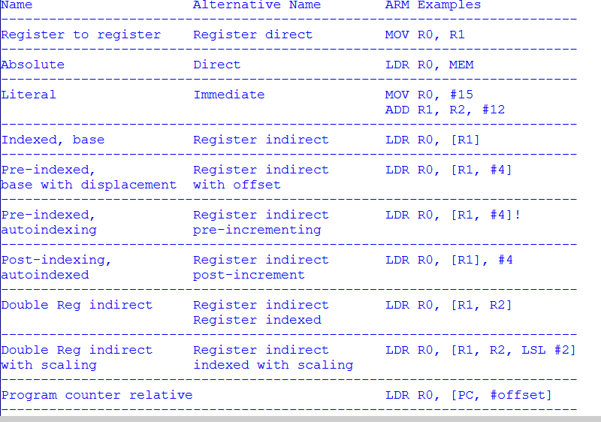
Data Transfer Instructions

Slide 5
Register to Register Mode
Register to Register or Register Direct Mode
  MOV R0, R1 ; R0 = R1
Data Processing Instructions

Slide 6

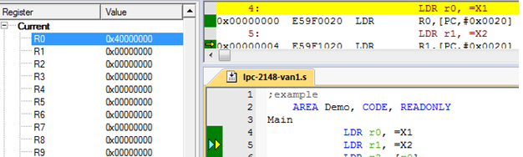
Absolute ( Memory Direct) Mode
AREA Demo, CODE, READONLY
Main
LDR r0, =X1 ; Load the memory address of variable X1 into GPR R0
LDR r1, =X2 ; Load the memory address of variable X2 into GPR R1
LDR r2, [r0]
MVN r3, r2
ADD r4, r3, #1
STR r4, [r1]
MOV r5, r4
NOP
NOP
LOOP B LOOP
AREA Data, DATA
X1 DCD &FFFFFFF6
X2 DCD &40000000
END
When the LDR instruction is executed, the result will be the address of variable X1 will be loaded into R0.
Data Memory Starts at 040000000
Data Processing Instructions

Slide 7
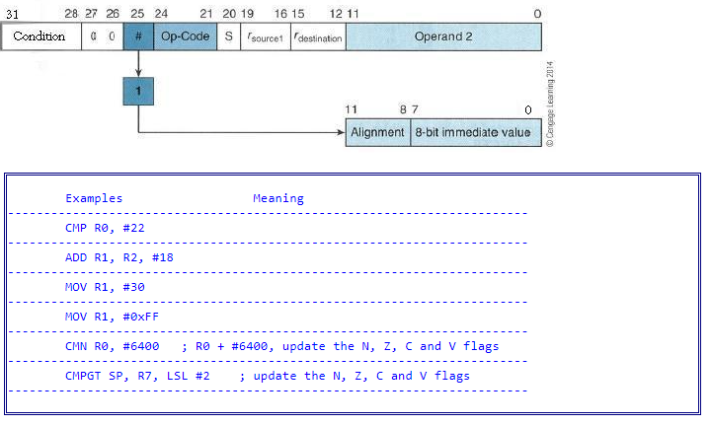
Literal or Immediate Addressing Mode
Data Processing Instructions

Slide 8
Base / Index / Register In-Direct
Register indirect addressing means that the location of an operand is held in a register. It is also called indexed addressing or base addressing.
Register indirect addressing mode requires three read operations to access an operand. It is very important because the content of the register containing the pointer to the operand can be modified at runtime. Therefore, the address is a variable that allows the access to the data structure like arrays.
Read the instruction to find the pointer register
Read the pointer register to find the oprand address
Read memory at the operand address to find the operand
Some examples of using register indirect addressing mode:
LDR R2, [R0] ; Load R2 with the word pointed by R0
STR R2, [R3] ; Store the word in R2 in the location
pointed by R3
Data Processing Instructions

Slide 9

Register Indirect Addressing with an Offset
ARM supports a memory-addressing mode where the effective address of an operand is computed by adding the content of a register and a literal offset coded into load/store instruction. For example,
Data Processing Instructions

Slide 10

ARM's Autoindexing Pre-indexed Addressing Mode
This is used to facilitate the reading of sequential data in structures such as arrays, tables, and vectors.
A pointer register is used to hold the base address. An offset can be added to achieve the effective address. For example,
Data Processing Instructions

Slide 11
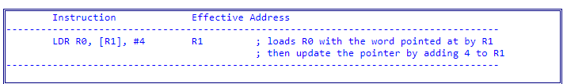
ARM's Auto indexing Post-indexed Addressing Mode
This is similar to the above, but it first accesses the operand at the location pointed by the base register, then increments the base register. For example,
Data Processing Instructions

Slide 12

PC Relative Addressing Mode
Register R15 is the program counter. If you use R15 as a pointer register to access operand, the resulting addressing mode is called PC relative addressing. The operand is specified with respect to the current code location.
Please look at this example,
Data Processing Instructions

Slide 13
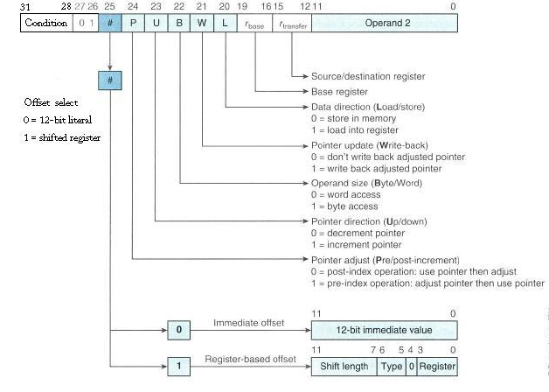
Encoding Format of Load and Store
Data Processing Instructions

Slide 14
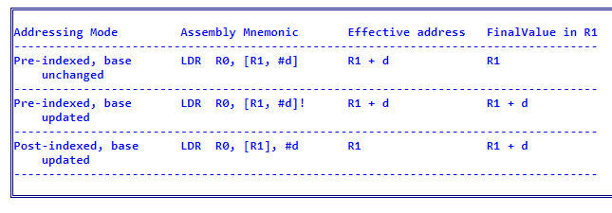
Summary of ARM’s Indexed Addressing
Data Processing Instructions

Slide 15
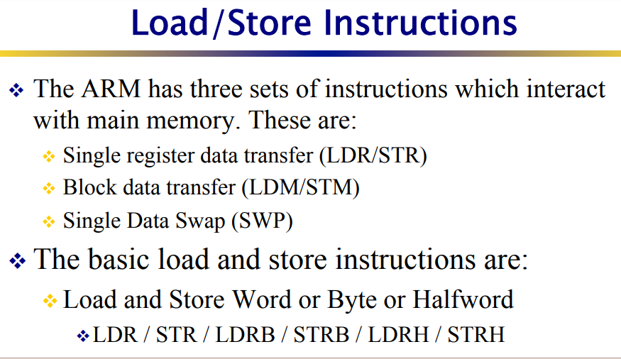
Data Processing Instructions

Slide 16
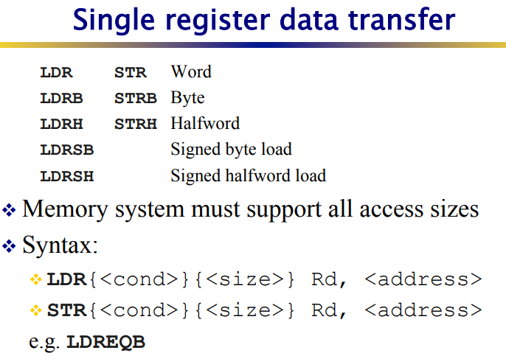
Data Processing Instructions

Slide 17
Data Transfer Instr.
Load/store instructions
Used to move Word, signed and unsigned Half Word and Byte to and from registers
Can be used to load PC
(if target address is beyond branch instruction range)
LDR | Load Word | STR | Store Word
LDRH | Load Half Word | STRH | Store Half Word
LDRSH | Load Signed Half Word | STRSH | Store Signed Half Word
LDRB | Load Byte | STRB | Store Byte
LDRSB | Load Signed Byte | STRSB | Store Signed Byte
Data Transfer Instructions

Slide 18
Data Transfer Instr.
Single Register Load
(Base Plus Offset Pre-indexed with Immediate Offset)
LDR R0, =0x40000000
LDR R1, [R0]
LDR R2, [R0, #4]
Base Plus Offset
Pre-indexed Addr. Mode
with Imm. Offset
 | Data M/M
0X40000000 | 0x12345678
0X40000004 | 0x23242526
0X40000008 | 0x00000003
 | Data
R0 | 0x00000000
R1 | 0x00000000
R2 | 0x00000000
R0
0x40000000
0x12345678
0x23242526
Data Transfer Instructions

Slide 19
Data Transfer Instr.
Single Register Load (Base Plus Offset
Pre-indexed with Immediate Offset and Write Back)
LDR R0, =0x40000000
LDR R1, [R0]
LDR R2, [R0, #4]!
Pre-indexed Addr. Mode
with Imm. Offset
& Write Back
(Auto-indexing)
 | Data M/M
0X40000000 | 0x12345678
0X40000004 | 0x23242526
0X40000008 | 0x00000003
 | Data
R0 | 0x00000000
R1 | 0x00000000
R2 | 0x00000000
R0
0x40000000
0x40000004
0x12345678
0x23242526
Data Transfer Instructions

Slide 20
Data Transfer Instr.
Single Register Load
(Base Plus Offset Post-indexed with Immediate Offset)
LDR R0, =0x40000000
LDR R1, [R0]
LDR R2, [R0], #4
Post-indexed Addr. Mode
With Imm. Offset
 | Data M/M
0X40000000 | 0x12345678
0X40000004 | 0x20202020
0X40000008 | 0x00000003
 | Data
R0 | 0x00000000
R1 | 0x00000000
R2 | 0x00000000
R0
0x40000000
0x40000004
0x12345678
0x12345678
Data Transfer Instructions

Slide 21
Data Transfer Instr.
Single Register Load and Store
LDR R0, =0x40000000
LDR R1, [R0]
LDR R2, [R0], #4
STR R2, [R0, #4]!
Post-indexed Addr. Mode
Pre-indexed Addr. Mode
with write back
 | Data M/M
0X40000000 | 0x12345678
0X40000004 | 0x23242526
0X40000008 | 0x00000003
 | Data
R0 | 0x00000000
R1 | 0x00000000
R2 | 0x00000000
R0
0x40000008
0x40000000
0x40000004
0x12345678
0x12345678
0x12345678
Data Transfer Instructions

Slide 22
ARM
Instruction Set
Data Transfer - II
Data Transfer Instructions

Slide 23
Data Transfer Instr.
Single Register Load (Decrement)
LDR R0, =0x40000004
LDR R1, [R0]
LDR R2, [R0, #-4]!
Pre-indexed Addr. Mode
with Write Back
(Auto-indexing)
 | Data M/M
0X40000000 | 0x12345678
0X40000004 | 0x23242526
0X40000008 | 0x00000003
 | Data
R0 | 0x00000000
R1 | 0x00000000
R2 | 0x00000000
0x40000004
0x40000000
R0
0x23242526
0x12345678
Data Transfer Instructions

Slide 24
Data Transfer Instr.
Single Register Load (Base Plus Offset Pre-indexed with Register Offset and Write Back)
LDR R0, =0x40000000
LDR R1, [R0]
LDR R3, [R0, R2]!
Pre-indexed Reg. Offset
with Write Back
(Auto-indexing)
 | Data M/M
0X40000000 | 0x12345678
0X40000004 | 0x23242526
0X40000008 | 0x00000003
 | Data
R0 | 0x00000000
R1 | 0x00000000
R2 | 0x00000004
R3 | 0X00000000
R0
0x40000000
0x40000004
0x12345678
0x23242526
Data Transfer Instructions

Slide 25
Data Transfer Instr.
Single Register Load (Base Plus Offset Pre-indexed with Scaled Register Offset and Write Back)
LDR R0, =0x40000000
LDR R1, [R0]
LDR R3, [R0, R2, LSL#2]!
Pre-indexed
Scaled Reg. Offset
with Write Back
 | Data M/M
0X40000000 | 0x12345678
0X40000004 | 0x23242526
0X40000008 | 0x00000003
 | Data
R0 | 0x00000000
R1 | 0x00000000
R2 | 0x00000001
R3 | 0X00000000
R0
0x40000000
0x40000004
0x12345678
0x23242526
Data Transfer Instructions

Slide 26
Data Transfer Instr.
Single Register Load Halfword
(Base Plus Offset Pre-indexed with Immediate Offset)
LDR R0, =0x40000000
LDRH R1, [R0]
LDRH R2, [R0, #4]
Base Plus Offset
Pre-indexed Addr. Mode
with Imm. Offset
 | Data M/M
0X40000000 | 0x12345678
0X40000004 | 0x23242526
0X40000008 | 0x00000003
 | Data
R0 | 0x00000000
R1 | 0x00000000
R2 | 0x00000000
R0
0x40000000
0x00005678
0x00002526
Data Transfer Instructions

Slide 27
Data Transfer Instr.
Single Register Load Byte
(Base Plus Offset Pre-indexed with Immediate Offset)
LDR R0, =0x40000000
LDRB R1, [R0]
LDRB R2, [R0, #4]
Base Plus Offset
Pre-indexed Addr. Mode
with Imm. Offset
 | Data M/M
0X40000000 | 0x12345678
0X40000004 | 0x23242526
0X40000008 | 0x00000003
 | Data
R0 | 0x00000000
R1 | 0x00000000
R2 | 0x00000000
R0
0x40000000
0x00000078
0x00000026
Data Transfer Instructions

Slide 28
Data Transfer Instr.
Single Register Load Signed Halfword
(Base Plus Offset Pre-indexed with Immediate Offset)
LDR R0, =0x40000000
LDRSH R1, [R0]
LDRSH R2, [R0, #4]
Base Plus Offset
Pre-indexed Addr. Mode
with Imm. Offset
 | Data M/M
0X40000000 | 0x1234FF10
0X40000004 | 0x23242526
0X40000008 | 0x00000003
 | Data
R0 | 0x00000000
R1 | 0x00000000
R2 | 0x00000000
R0
0x40000000
0xFFFFFF10
0x00002526
Data Transfer Instructions

Slide 29
Data Transfer Instr.
Single Register Load Signed Byte
(Base Plus Offset Pre-indexed with Immediate Offset)
LDR R0, =0x40000000
LDRSB R1, [R0]
LDRSB R2, [R0, #4]
Base Plus Offset
Pre-indexed Addr. Mode
with Imm. Offset
 | Data M/M
0X40000000 | 0x123456FF
0X40000004 | 0x23242526
0X40000008 | 0x00000003
 | Data
R0 | 0x00000000
R1 | 0x00000000
R2 | 0x00000000
R0
0x40000000
0xFFFFFFFF
0x00000026
Data Transfer Instructions

Slide 30
Example
R0 = 0x00000000
R1 = 0x00090000
mem32[0x00009000] = 0x01010101
mem32[0x00009004] = 0x02020202
LDR R0, [R1, #4]!
Pre-indexing with writeback:
R0 = 0x02020202
R1 = 0x00009004
LDR R0, [R1, #4]
Pre-indexing:
R0 = 0x02020202
R1 = 0x00009000
LDR R0, [R1], #4
Post-indexing:
R0 = 0x01010101
R1 = 0x00009004
Data Transfer Instructions

Slide 31
Data Transfer Instr.
Load/Store - Addressing Modes
LDR R0, =0X40000000 ; R0 = 0X40000000
LDR R1, [R0] ; R1 = mem32[0x40000000]
LDR R1, [R0, #4] ; R1 = mem32[0x40000000 + 4]
LDR R1, [R0, #-4] ; R1 = mem32[0x40000000 - 4]
LDR R1, [R0, R2] ; R1 = mem32[0x40000000 + R2]
LDR R1, [R0, -R2] ; R1 = mem32[0x40000000 - R2]
LDR R1, [R0, R2, LSL#2] ; R1 = mem32[0x40000000 + R2<<2]
LDR R1, [R0, -R2, LSL#2] ; R1 = mem32[0x40000000 - R2<<2]
LDRH R1, [R0] ; R1 = mem16[0x40000000]
LDRB R1, [R0] ; R1 = mem8[0x40000000]
LDRSH R1, [R0] ; R1 = Sign Ext. mem16[0x40000000]
LDRSB R1, [R0] ; R1 = Sign Ext. mem8[0x40000000]
STR R1, [R0] ; mem32[0x40000000] = R1
Data Transfer Instructions

Slide 32
Thank
You
Data Processing Instructions

